Slide 1
2017
Conference ONLY: June 24-July 1 Extended Trip: July 1-5th
Webinar #1

Slide 2
Tonight We Will Cover
Welcome
Introductions
Fundraising for CWF
CWF Overview
Service Learning Procedures
Review of Paperwork
Agenda

Slide 3
CWF 2017
WHO ARE YOU?
Where are you from?
What are you looking forward to?
Introductions

Slide 4
How to raise the $$$
Jade Lassaga
Wheatland 4-H club
Yuba county
FUNDRAISING

Slide 5
CWF 2017
CWF Conference Overview
CWF Extended Trip
CWF Travel
OVERVIEW

Slide 6
CWF CONFERENCE
OVERVIEW
Notes:
For more than 50 years, thousands of high school youth from all across the country have travelled to Washington, DC each summer to partake in the preeminent 4‑H citizenship and leadership experience—Citizenship Washington Focus.
CWF is more than just another DC field trip – 4‑H’ers learn essential civic leadership skills and leave with the tools that will allow them to bring about real change in their communities.
Let’s take a look at what a typical CWF Conference looks like…

Slide 7
CWF Extended Trip
Gettysburg, PA
Philadelphia, PA
Baltimore, MD
OVERVIEW

Slide 8
Travel To: CWF
BWI ARRIVALS
SMF-2:55pm
OAK-2:50pm
SMF (Jen & Michelle)
Sacramento, Lassen, Butte, Nevada
6:55AM
OAK (Kelly & Scott)
Madera, Marin, Monterey
6:45am
OVERVIEW

Slide 9
Travel From: CWF
BWI Departure
7-1-17
9:10 am
Madera & Marin
ARRIVALS
7-1-17
OAK-12 PM
OVERVIEW

Slide 10
Travel From: CWF
BWI Departure
7-5-17
2 PM
Jen & Michelle
Sacramento, Lassen, Butte, Nevada
ARRIVALS
7-5-17
SMF-4:35 PM
OVERVIEW

Slide 11
Travel From: CWF
BWI Departure
7-5-17
1:40 PM
Kelly
Monterey
ARRIVALS
7-5-17
OAK-4:25 PM
OVERVIEW

Slide 12
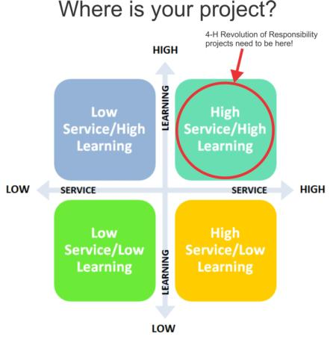
What is it?
Service learning is a where a community service project is strengthened by learning about the larger issue that the project is connected to.
What are the challenges of the identified issue?
How does it affect the local community?
What need can we meet with a community project?
Service-Learning
Notes:
Brainstorm Community Issues –Explore the media, talk with people, connect with decision makers
Select a Strategy – Focus on a goal for your group within the larger issue, choose a project, set a goal and write it down
Engage the community
Create an Action Plan – list steps to follow to reach your goal, delegate responsibilities to team members, plan a budget and decide what resources are needed
Identify strategies to involve others
Deal with obstacles and do problem solving, evaluate along the way
Share your results – include reflections from the group and from those served by your project through print, video and media
Celebrate your success and tell your story.

Slide 13
Food insecurity
Identify a need around this year’s theme
Explore how food insecurity impacts your community and identify a community need that you want to meet
Service-Learning
Notes:
Brainstorm Community Issues –Explore the media, talk with people, connect with decision makers
Select a Strategy – Focus on a goal for your group within the larger issue, choose a project, set a goal and write it down
Engage the community
Create an Action Plan – list steps to follow to reach your goal, delegate responsibilities to team members, plan a budget and decide what resources are needed
Identify strategies to involve others
Deal with obstacles and do problem solving, evaluate along the way
Share your results – include reflections from the group and from those served by your project through print, video and media
Celebrate your success and tell your story.

Slide 14
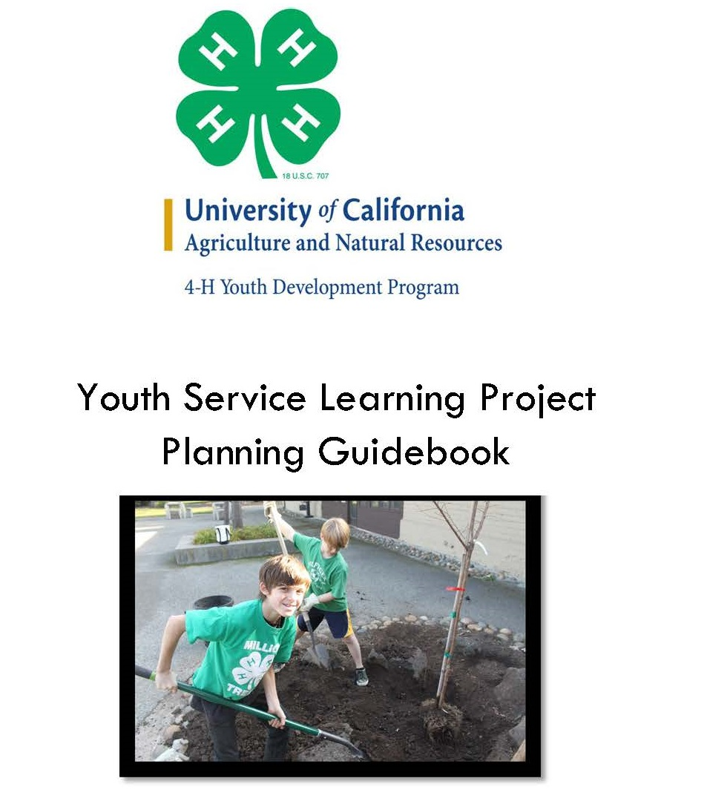
Food insecurity
Follow the Service Learning Planning guide
This guide with other resources can be found on the state website
http://4h.ucanr.edu/Projects/Citizenship/Citizenship_Resources/PlanAction/
Service-Learning
Notes:
Brainstorm Community Issues –Explore the media, talk with people, connect with decision makers
Select a Strategy – Focus on a goal for your group within the larger issue, choose a project, set a goal and write it down
Engage the community
Create an Action Plan – list steps to follow to reach your goal, delegate responsibilities to team members, plan a budget and decide what resources are needed
Identify strategies to involve others
Deal with obstacles and do problem solving, evaluate along the way
Share your results – include reflections from the group and from those served by your project through print, video and media
Celebrate your success and tell your story.

Slide 15
Food insecurity
Submit your proposal
Once your project has been approved, you can begin working on it!
Service-Learning
Notes:
Brainstorm Community Issues –Explore the media, talk with people, connect with decision makers
Select a Strategy – Focus on a goal for your group within the larger issue, choose a project, set a goal and write it down
Engage the community
Create an Action Plan – list steps to follow to reach your goal, delegate responsibilities to team members, plan a budget and decide what resources are needed
Identify strategies to involve others
Deal with obstacles and do problem solving, evaluate along the way
Share your results – include reflections from the group and from those served by your project through print, video and media
Celebrate your success and tell your story.

Slide 16
Food insecurity
Complete project by 12/31/17
YOUR 4-H Delivers story will need to be submitted before certificates of completion and pins are awarded.
Service-Learning
Notes:
Brainstorm Community Issues –Explore the media, talk with people, connect with decision makers
Select a Strategy – Focus on a goal for your group within the larger issue, choose a project, set a goal and write it down
Engage the community
Create an Action Plan – list steps to follow to reach your goal, delegate responsibilities to team members, plan a budget and decide what resources are needed
Identify strategies to involve others
Deal with obstacles and do problem solving, evaluate along the way
Share your results – include reflections from the group and from those served by your project through print, video and media
Celebrate your success and tell your story.

Slide 17
What questions do you have
About what we have discussed tonight?
Q & A
Notes:
Brainstorm Community Issues –Explore the media, talk with people, connect with decision makers
Select a Strategy – Focus on a goal for your group within the larger issue, choose a project, set a goal and write it down
Engage the community
Create an Action Plan – list steps to follow to reach your goal, delegate responsibilities to team members, plan a budget and decide what resources are needed
Identify strategies to involve others
Deal with obstacles and do problem solving, evaluate along the way
Share your results – include reflections from the group and from those served by your project through print, video and media
Celebrate your success and tell your story.

Slide 18
SAVE THE DATE
3/21/17
Orientation Webinar #2-6:30pm-8pm
Dress code
Capitol Hill Day
Paperwork Check-in
Next Meeting
Notes:
Brainstorm Community Issues –Explore the media, talk with people, connect with decision makers
Select a Strategy – Focus on a goal for your group within the larger issue, choose a project, set a goal and write it down
Engage the community
Create an Action Plan – list steps to follow to reach your goal, delegate responsibilities to team members, plan a budget and decide what resources are needed
Identify strategies to involve others
Deal with obstacles and do problem solving, evaluate along the way
Share your results – include reflections from the group and from those served by your project through print, video and media
Celebrate your success and tell your story.

