Slide 1
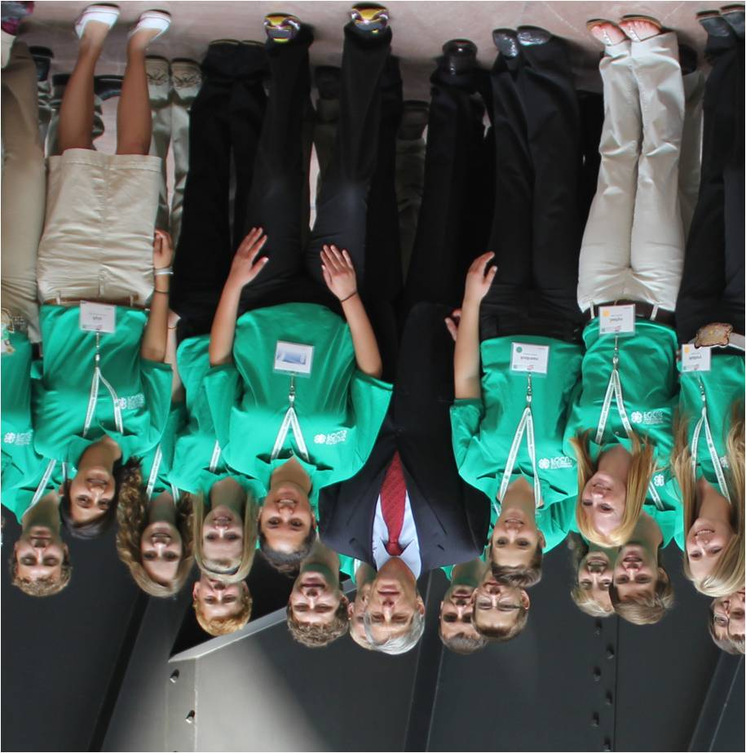
Delegate Orientation #2

Slide 2
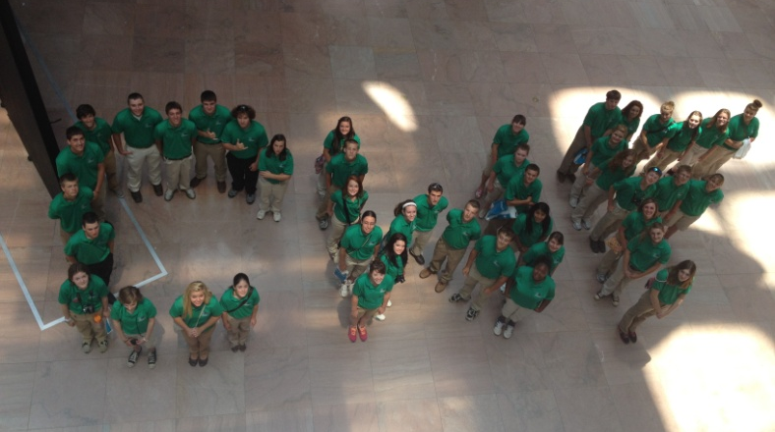
This Orientation Will Cover…
Overview
CWF 2017 Schedule Updates
Capitol Hill Day Orientation
Service Learning Projects-Check in on submissions
Workshop and Committees
Additional Travel Days
Reminders & Deadlines

Slide 3
Trip Highlights
Schedule Updates
Holocaust Museum
Capitol Tour (Back up booking)
Ford’s Theater
4th of July Fireworks Cruise (Pending)

Slide 4
Preparing for your Legislative Appointments

Slide 5
What We Will Cover
Background of 4-H and it’s public partnership
Prepping for Capitol Hill Day
Public Values
Delivering Your Message
Reminders
Follow up
Appointment schedule- June 28
Notes:
Make your appointments between 9:30 & 4:00pm. This is the day to do a Capitol Tour if your Congressperson offers.

Slide 6
4-H’s Public Partnership USDA & Land-grant institutions
1914: Smith- Lever Act
1918: term “4-H Club” used by the USDA
1924: Clover emblem was patented
18 USC707
1948: Congress approved 4-H Club and emblem as legal tittle
1981: Public Law 97-98

Slide 7
Where Does 4-H Fit?

Slide 8
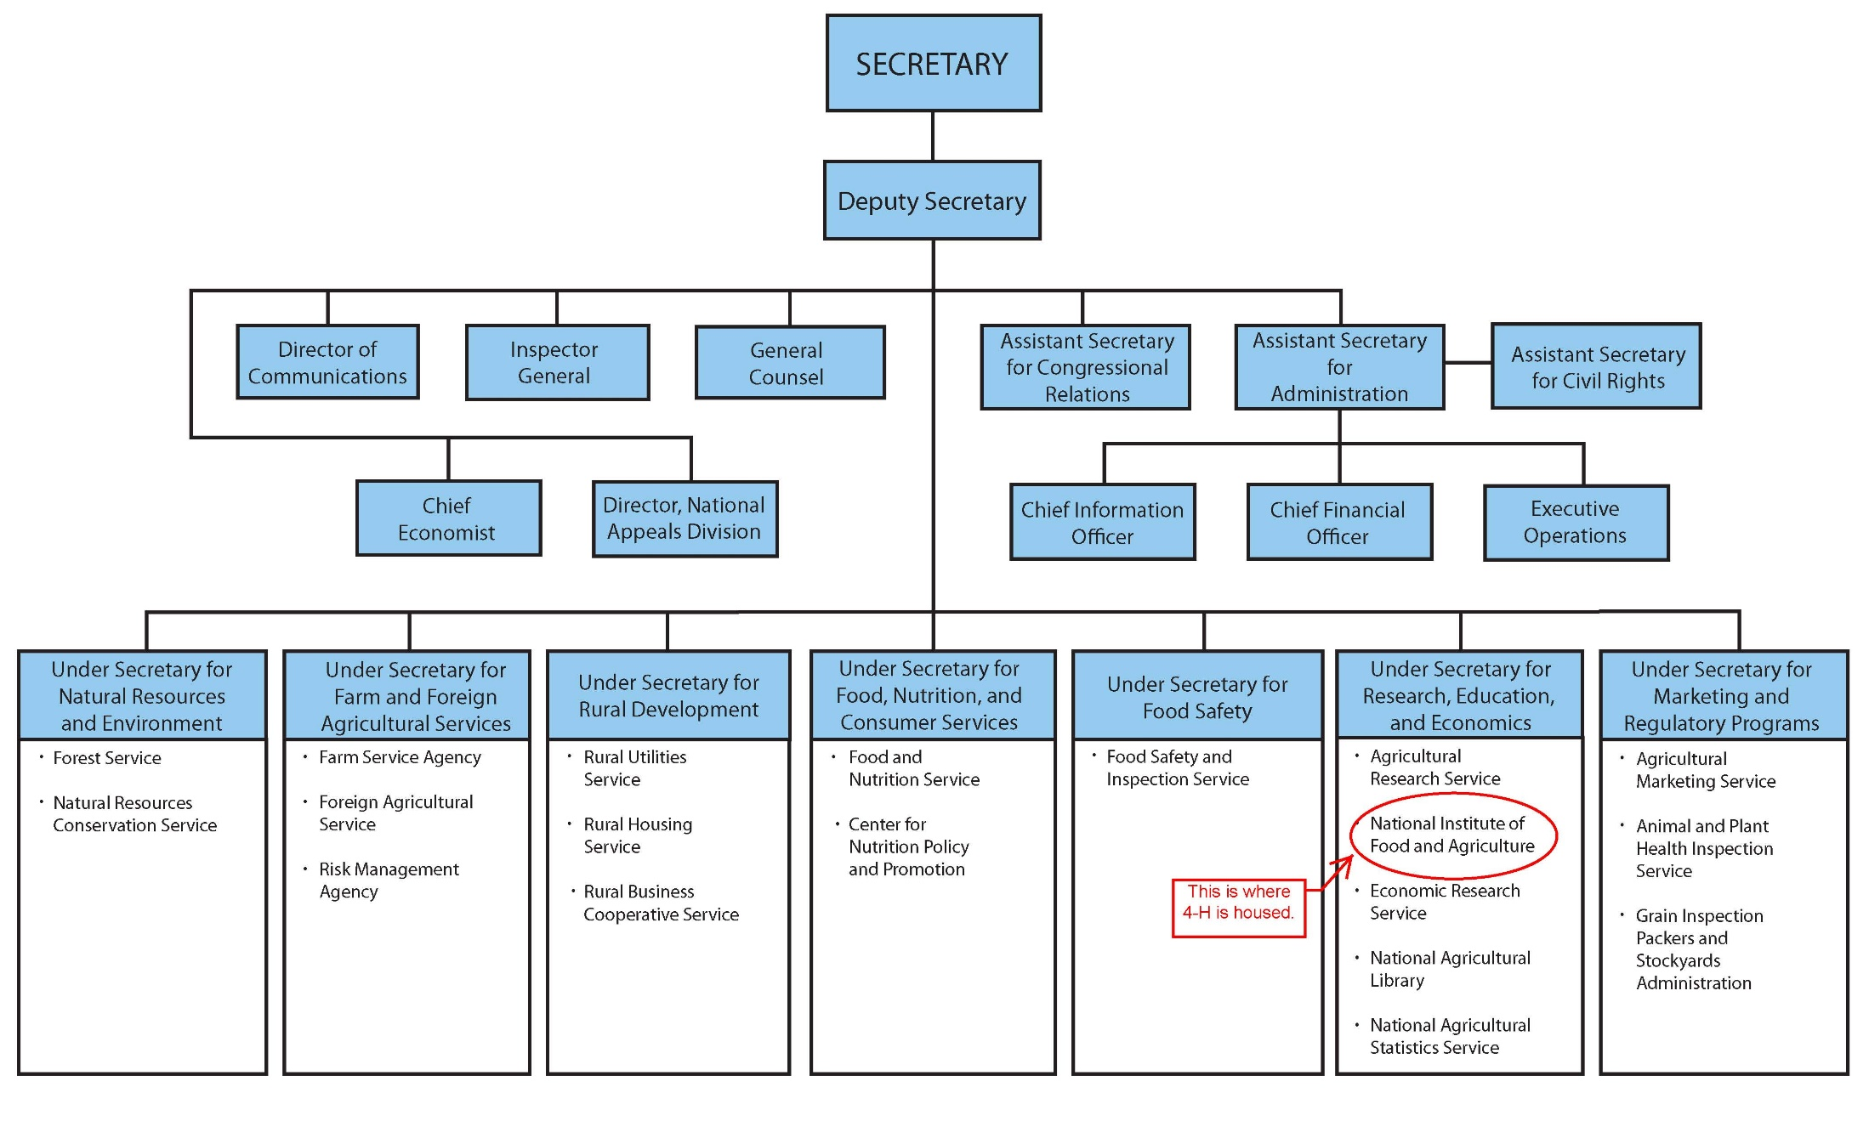

Slide 10
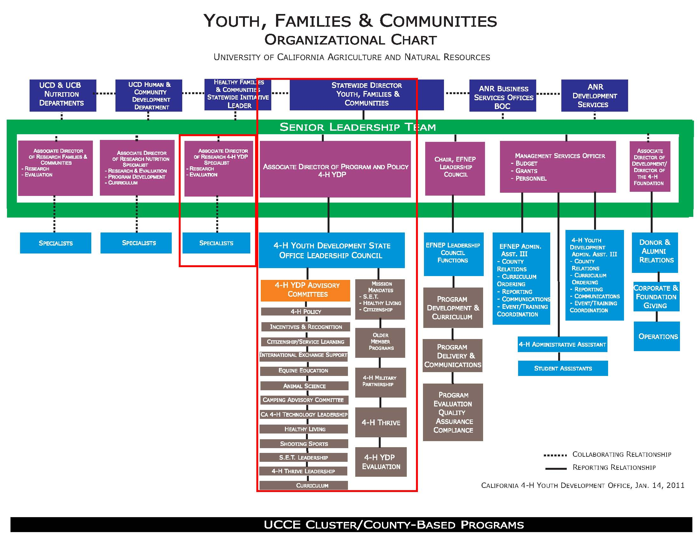

Slide 11
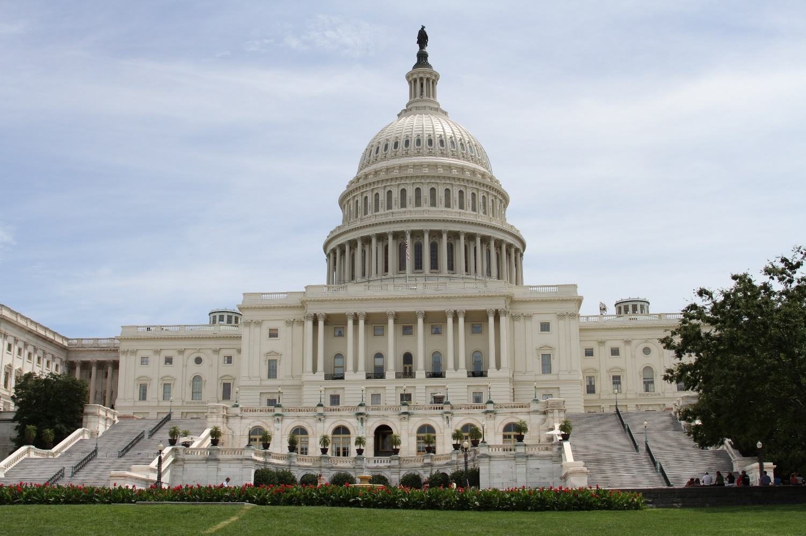
Prepping for Capitol Hill Visits
Notes:
Jenna

Slide 12
Purpose of Capitol Hill Visits
Visit with federal legislators and decision makers to observe the political process in action.
Help Extension and 4-H build relationships with stakeholders.
Build political and public support for Extension and 4-H through consistent and targeted communication with decision‐makers.

Slide 13
Purpose cont.
Broaden understanding of public policy issues that impact Extension and Extension clientele.
Learn how the changing political environment affects support for Extension and 4-H.
Opportunity to experience the political world of our nation’s capitol.
Enhance advocacy and public policy education skills - increase your knowledge and effectiveness in working in your local political arena.
Learn about the federal structure that supports Extension and 4-H
Notes:
Anything else you would like to gain from this experience?

Slide 14
Prepping for Congressional Visits
Meet with your state’s Extension and 4-H administration to discuss your visit to Capitol Hill.
Have a specific message for you to carry to your visit
Provide useful tips or information based on personal knowledge of your Congressional delegation
Schedule appointments, then confirm your appointments
Collect or prepare briefing information
Notes:
(not more than 1-2 pages) to leave with Members and staff. Use pictures in your reports and use bullet points rather then paragraphs.

Slide 15
Prepping-Research
Conduct research about your Member of Congress:
Learn your which district your Congressman represents within your state. Do you live in his/her district?
Term in Office
Political Party
Educational Background
Occupational Background
Committee Assignments
Leadership Positions in the House or Senate
Which issues are most important to the Member?
Familiarity with Extension and 4-H; any special relationships, i.e. a 4-H alumna?
Who are the Member’s aides?

Slide 16
Prepping-Summary Sheet
Prepare a Summary Sheet of Key Information
Notes:
What would go here?
I would suggest an excel sheet outlining everything you have found-post on CT and let others comment

Slide 17
Prepping cont.
Know the basic process of how funding decisions are made.
Prepare a one-page account of the important points you wish to make during your visit.
Prepare a list of questions you would like to ask if given the opportunity during the visit.
Take a camera just in case you have photo opportunities.
Notes:
Do we now understand where our funds come from? Do we understand how we are connected to USDA?
What type of questions would you like to ask?

Slide 18
Prepping cont.
Develop a message that is direct, concise, and short - plan on 15 minutes total for your group.
Develop a 2-minute version of your message just in case their schedule changes – aka, the elevator speech.
Select no more than two or three educational programs or issues, and focus on them.
Don’t talk in 4-H jargon.
Emphasize outcomes of the program and how it makes a difference in people’s lives.
Notes:
Introduce yourselves.
Describe the purpose for your visit.
No more than two or three educational programs or issues and focus on them.

Slide 19
Content of Message
If you are planning to talk about issues or problems in your community, be prepared to offer solutions
TELL YOUR 4-H STORY. Make it personal to you, your family, your club, your community
Emphasize outcomes of the program and how it makes a difference in people’s lives.
Public Values.
Do not overwhelm the Member or staff with materials. A large packet of information will likely not get looked at.
Notes:
Introduce yourselves.
Describe the purpose for your visit.
Describe how 4-H is administered by our State Land Grant College and Extension program
No more than two or three educational programs or issues and focus on them.

Slide 20
Delivering Your Message
Practice giving your 15 minute and 2- minute versions of your presentation.
Determine who will take the lead to get the conversation rolling.
As youth, you may choose to ask questions about how or why the Member or staffer got into his/her role of public service, or similar questions that will inform your potential interest in serving.

Slide 21
What are Public Values?
Public values are "the value of a program to those who do not directly benefit from the program." ~ Laura Kalambokidis, University of Minnesota Extension
A private value is a "personal value derived directly from an Extension educational opportunity." ~ Nancy Franz, ISUEO
Notes:
Organizational sustainability for Extension now relies on translating the value of what we do to a wider audience
than we have in the past.
Private/personal/internal values are those that those who participate in the program hold.
“4-H is a positive youth development program”
Public values are private/personal/internal values that are framed in a way that is accessible and important to a broader audience
Private or Personal Value Public Value
Youth and adults develop leadership → skills Increasing civic participation
Youth and adults increase their intake of
fruits and vegetables → Decreasing health care costs
Reduced use of pesticides -→ Improved water quality

Slide 22
Why are they important?
Translates the value of what we do to a wider audience.
Show how what we do benefits a broader audience, e.g., stakeholders.
Important for sustainability, especially in times of limited resources.

Slide 23
California 4-H Public Values
4-H increases the economic sustainability, growth, and prosperity, of California's global economy. 4-H youth are more likely than their non 4-H counterparts, to enter the workforce better prepared to collaborate, think critically, solve problems, and be innovative. These are skills that lead to a competent workforce enabling industries to be innovative and vibrant, and contribute to increased income and sales tax revenue for our communities and state, thereby improving the economic growth of California's global economy.
Notes:
We are excited to announce, that we have identified 6 public values statements for the 4-H community. These public value statements represent the hard work and thinking of 4-H volunteers, youth, advisors, representatives, and statewide staff during our full-day planning meeting, and are as follows:
4-H increases the economic sustainability, growth, and prosperity, of California's global economy.
Background:
4-H youth are more likely than their non 4-H counterparts, to enter the workforce better prepared to collaborate, think critically, solve problems, and be innovative. These are skills that lead to a competent workforce enabling industries to be innovative and vibrant, and contribute to increased income and sales tax revenue for our communities and state, thereby improving the economic growth of California's global economy.

Slide 24
California 4-H Public Values
4-H increases civic engagement to strengthen communities. 4-H youth, as young as 5, engage in service learning projects to identify needs in their community by building youth-adult partnerships to develop creative solutions to real issues. 4-H provides an enormous amount of civic engagement services to communities across California. For example, statewide, youth and adults contribute more than 100,000 hours to respond to and address critical community issues, which strengthens communities through civic engagement.
Notes:
4-H increases civic engagement to strengthen communities. Background:
4-H youth, as young as 5, engage in service learning projects to identify needs in their community by building youth-adult partnerships to develop creative solutions to real issues. 4-H provides an enormous amount of civic engagement services to communities across California. For example, statewide, youth
and adults contribute more than 100,000 hours to respond to and address critical community issues, which strengthens communities through civic engagement.

Slide 25
California 4-H Public Values
4-H ensures a safe, sustainable, and secure food supply. 4-H is California’s premier organization for training young agriculturalists and its research-based curricula promotes cutting-edge practices. More than one-third of the activities that 4-H youth engage in include agricultural-related projects, providing leadership continuity to California’s $37.5 billion agricultural industry and ensuring a safe, steady, food supply for California and the world.
Notes:
4-H ensures a safe, sustainable, and secure food supply.
Background:
4-H is California’s premier organization for training young agriculturalists and its research-based curricula promotes cutting-edge practices. More than one-third of the activities that 4-H youth engage in include agricultural-related projects, providing leadership continuity to California’s $37.5 billion agricultural industry and ensuring a safe, steady, food supply for California and the world.

Slide 26
California 4-H Public Values
4-H increases personal responsibility that positively contributes to communities.
Participating in 4-H programs strengthen youth’s positive individual characteristics such as being responsible and accountable, being committed and loyal, and having integrity. These are core aspects of what is considered having “character,” and according to Dr. Rand Conger at UC Davis, research shows that character is an important aspect of development that underlies individual success in careers and higher education. Undoubtedly, these interpersonal characteristics not only benefit the individual but create healthy and strong work environments. Thus, the personal qualities that 4-H develops in each member creates a stronger economic, social, and environmental base in communities where 4-Hers live, thereby benefiting and leading to success for the broader community.
Notes:
4-H increases personal responsibility that positively contributes to communities.
Background:
Participating in 4-H programs strengthen youth’s positive individual characteristics such as being responsible and accountable, being committed and loyal, and having integrity. These are core aspects of what is considered having “character,” and according to Dr. Rand Conger at UC Davis, research shows that character is an important aspect of development that underlies individual success in careers and higher education. Undoubtedly, these interpersonal characteristics not only benefit the individual but create healthy and strong work environments. Thus, the personal qualities that 4-H develops in each member creates a stronger economic, social, and environmental base in communities where 4-Hers live, thereby benefiting and leading to success for the broader community.

Slide 27
California 4-H Public Values
4-H reduces public costs to society. Through participation in 4-H, youth develop specific skills that are important for jobs and careers such as leaderships skills, ability to organize and lead meetings, set and achieve goals, financial awareness, and social skills. These skills arguably lead to greater physical and emotional health and educational and occupational success. Thus, 4-H involvement fosters self-sufficiency and leads to less dependence on costly public social services.
Notes:
4-H reduces public costs to society.
Background:
Through participation in 4-H, youth develop specific skills that are important for jobs and careers such as leaderships skills, ability to organize and lead meetings, set and achieve goals, financial awareness, and social skills. These skills arguably lead to greater physical and emotional health and educational and occupational success. Thus, 4-H involvement fosters self-sufficiency and leads to less dependence on costly public social services.

Slide 28
California 4-H Public Values
4-H improves public health and safety. 4-H education programs address health, agricultural, and environmental literacy. Through real world experiences that cultivate self-esteem, self-confidence, and leadership, youth and adults adopt preventative and practices that result in reduced risky behaviors and improved healthy lifestyle habits. Program impacts include improved public health and safety and reduced costs to the state and community.
Notes:
4-H improves public health and safety.
Background:
4-H education programs address health, agricultural, and environmental literacy. Through real world experiences that cultivate self-esteem, self-confidence, and leadership, youth and adults adopt preventative and practices that result in reduced risky behaviors and improved healthy lifestyle habits. Program impacts include improved public health and safety and reduced costs to the state and community.

Slide 29
Reminders…
Confirm your appointment the day before your visit.
Arrive 20 minutes before your scheduled visit. Allow time for security checks at entrances. Don’t be late!
Don’t be disappointed if your legislator is late.
Don’t be disappointed if your legislator is unable to meet with you, the aides will be knowledgeable about your problem’s and the legislator’s point of view.
Don’t overstay your welcome.
Request to take a photo with your Congressman.

Slide 30
During Your Visit:
Find out what they are interested in.
Keep notebook.
Record:
Name of Congressional Member visited (or Aide)
Date of visit
Names of 4-H Team who were part of the visit
Major talking points
Congress Member of Aide comments, requests, promises that require follow-up action
Other comments/observations about the visit
Be specific about what programming is going on their district and what concerns they have that aren’t being addressed
Get business cards from everyone that you meet with.

Slide 31
Upon Return
Send follow-up email or thank you note
Thank them for meeting
Remind them of your key messages
Provide answers to any unanswered questions or additional information you promised.
Work with your local or state office to visit your Member of Congress back home, or invite them to a prominent 4-H program.
Get to know their Legislative Assistants.
Attend county events and find ways we can help them. Go where they are going to be.

Slide 32
Questions?

Slide 33
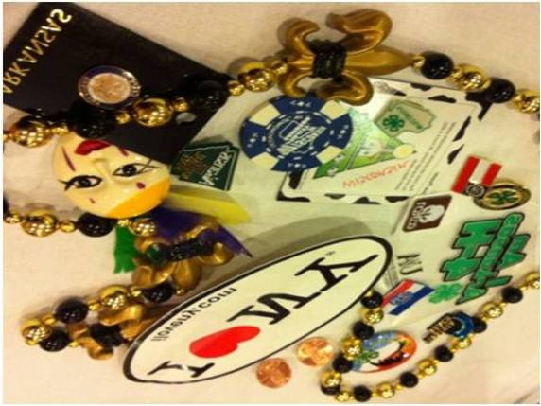
Schedule
Sunday
Opening ceremony
Get pumped up and ready to go as you gather with delegates from all across the country to kick off an Awesome time in and around Washington, D.C.
Pin Trade
A time honored CWF tradition, Pin Trade is your opportunity to show off your delegation pride with a little local swag. The state office will provide state of CA pins to trade with others
Notes:
Pins for trinket trade to be provided by the CA 4-H state office

Slide 34
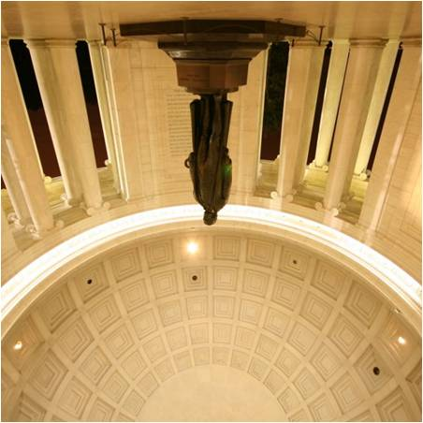
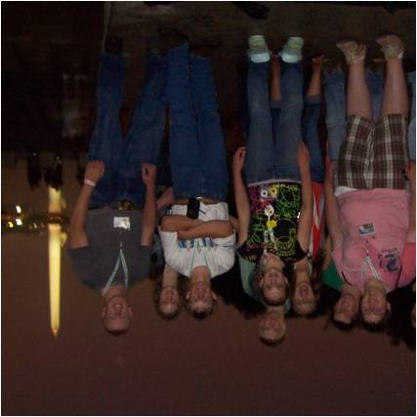
Schedule
Monday
Joint Congressional Issue Workshop
You’ve drafted your bill, now debate your convictions
and hear amendments from the challenging side
Nightview of Washington D.C.
Visit several Capitol City favorites and see
them in a whole new light, moonlight!

Slide 35
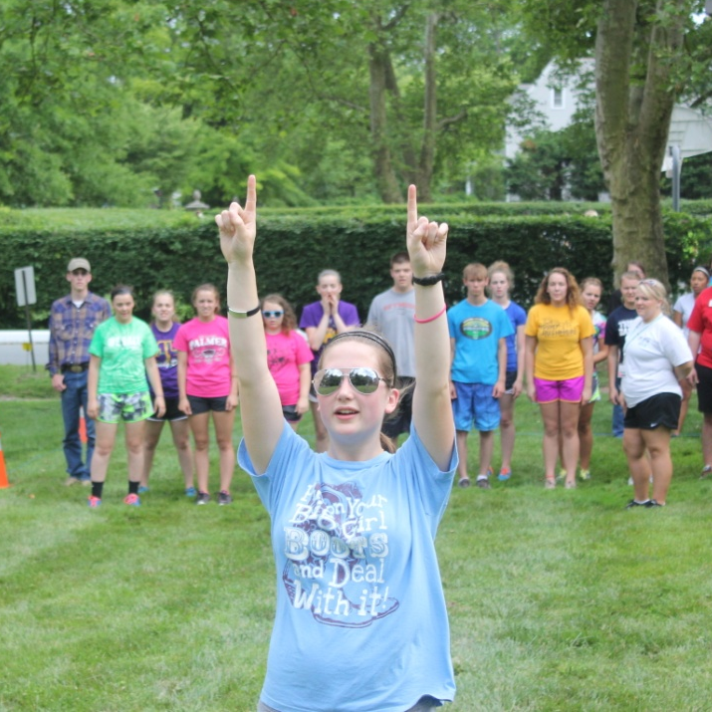
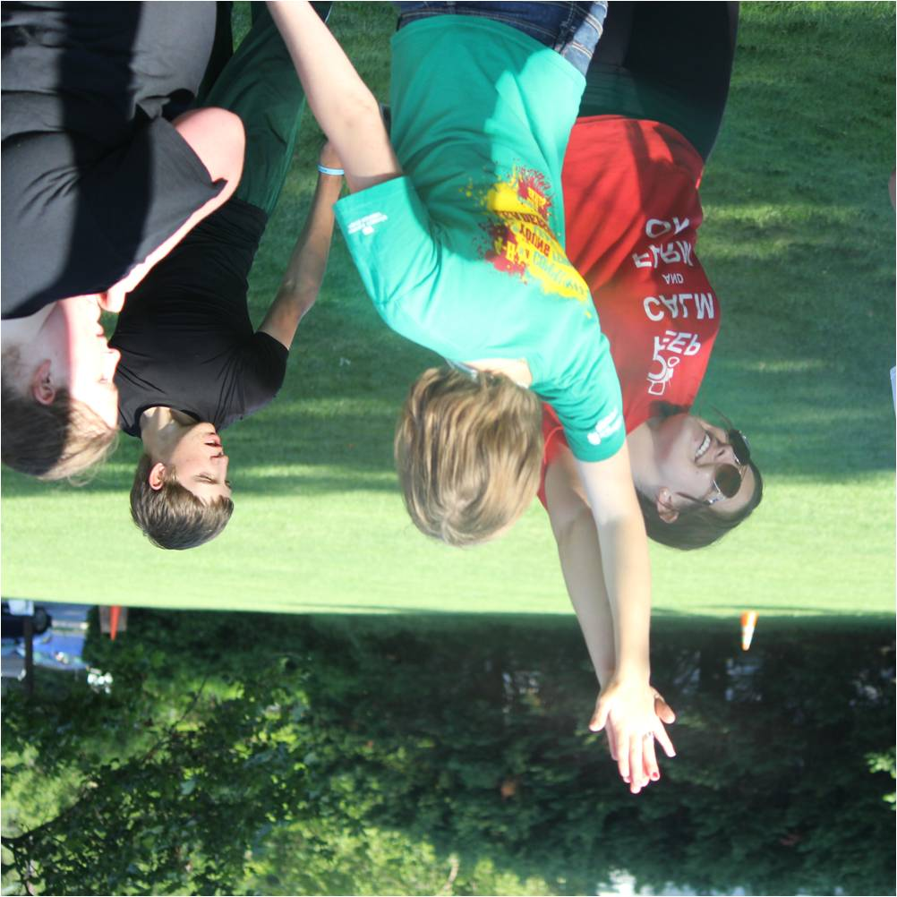
Schedule
Tuesday
Derby
planned by the Focus on Healthy Living
committee, Derby is a high energy time during
CWF where delegates can show off their
athletic prowess and enjoy the summer sun.
*Make sure you bring closed toed shoes and clothes
You don’t mind getting wet or dirty.

Slide 36
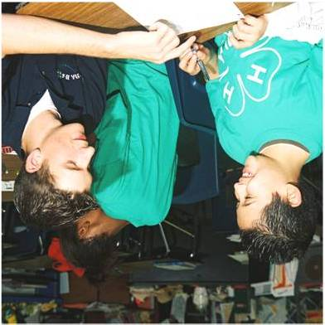
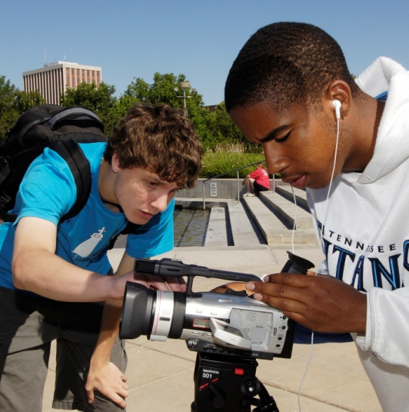
Schedule
Tuesday
Action Planning
Citizenship is not a spectators sport.
During the Action Planning session,
delegates will identify issues in their
community and lay the groundwork
to take action!

Slide 37
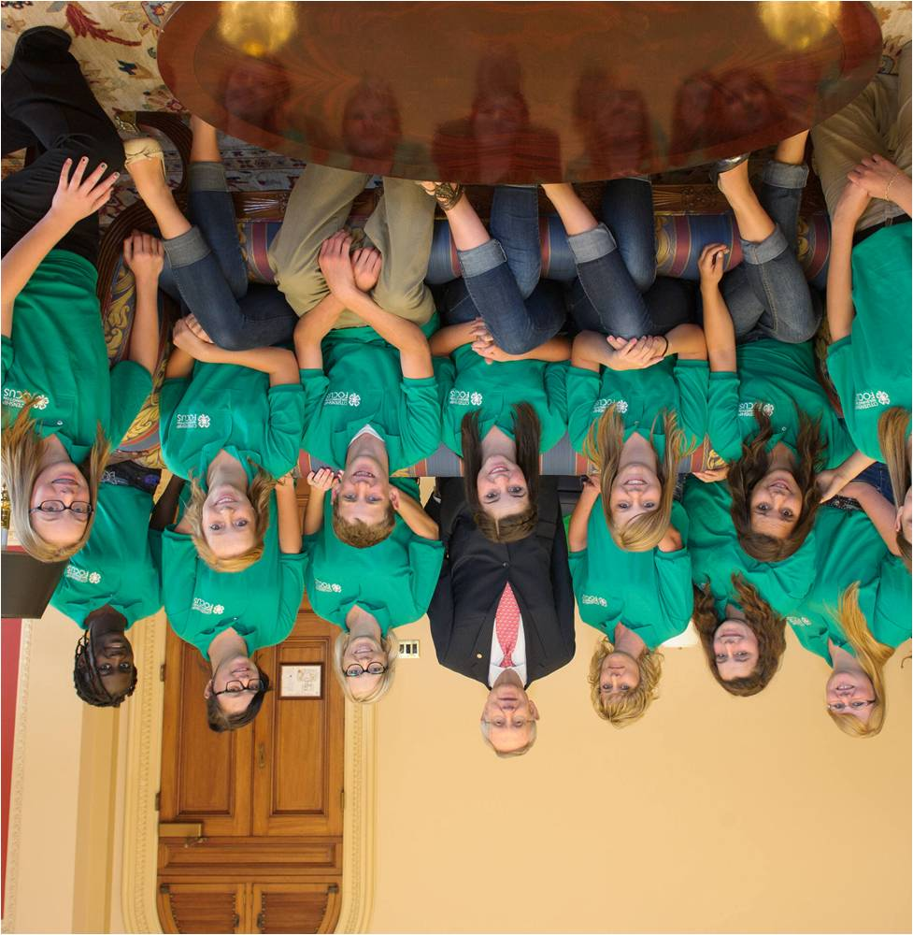
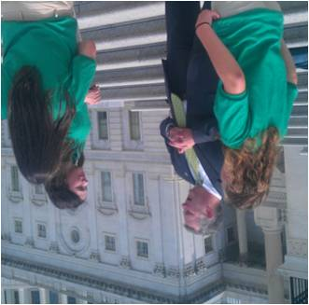
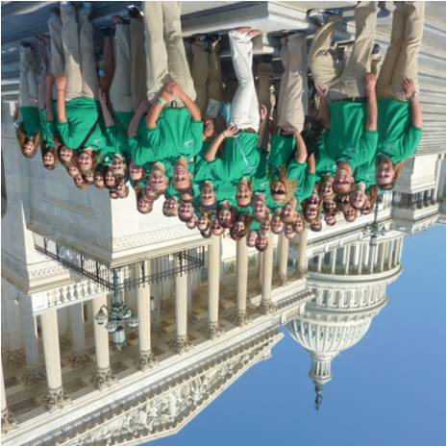
Schedule
Wednesday
Capitol Hill Day
Once you set your appointment, email Scott the time.
Other sites to see if you have time after your appointment
Library of Congress
United States Supreme Court
Folger Shakespeare Library
United States Botanic Garden
National Postal Museum:

Slide 38
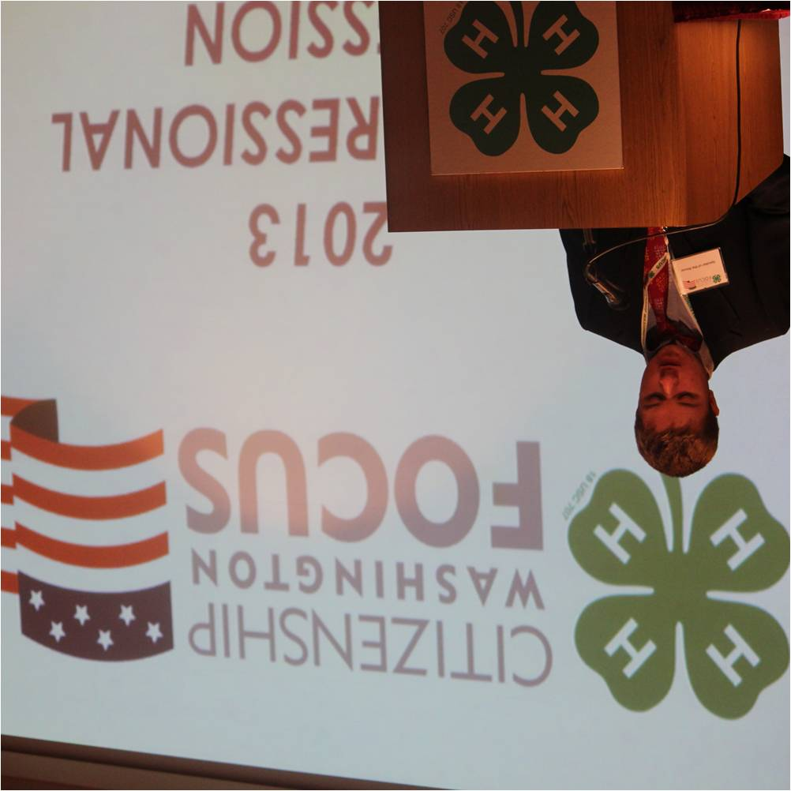
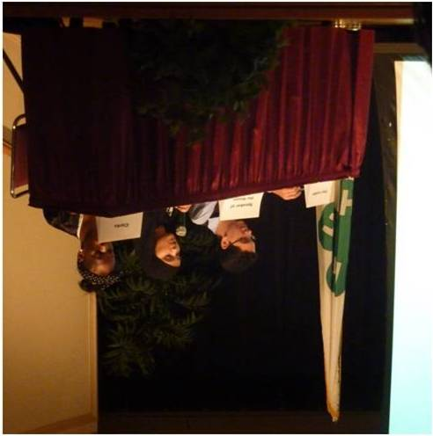
Schedule
Thursday
Congressional Session-
You and your workshop group have researched your
topic, now it’s time to bring your legislation
to the floor of the CWF Congress for a vote!
Notes:
State’s Night out our cultural event is Toby's Dinner Theatre-Joseph and the Technicolor Dream Coast

Slide 39
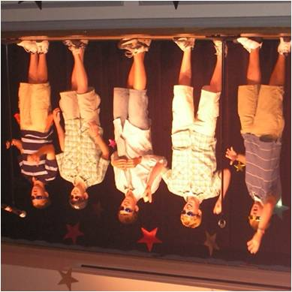
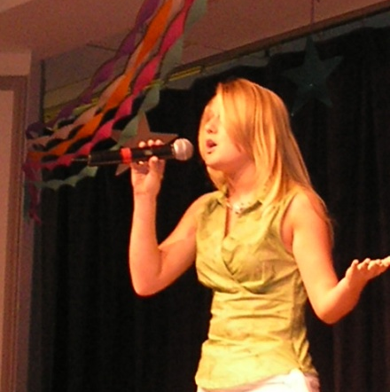
Schedule
Friday
Talent Show
Get ready to Show your talents Organized by the Focus on Talent Committee, the Talent Show gives delegates the opportunity to display their talents before the entire session delegation
DANCE
What better way to cap off an
extraordinary week?! Get down and
dance into the night with your fellow
delegates before departing to continue
as local, national, and global leaders
Notes:
Questions about the schedule ?

Slide 40
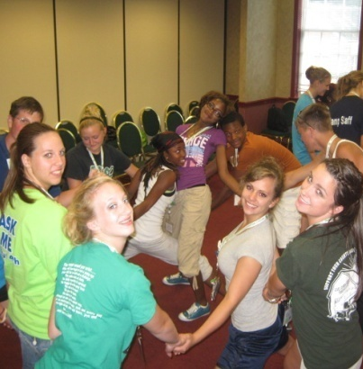
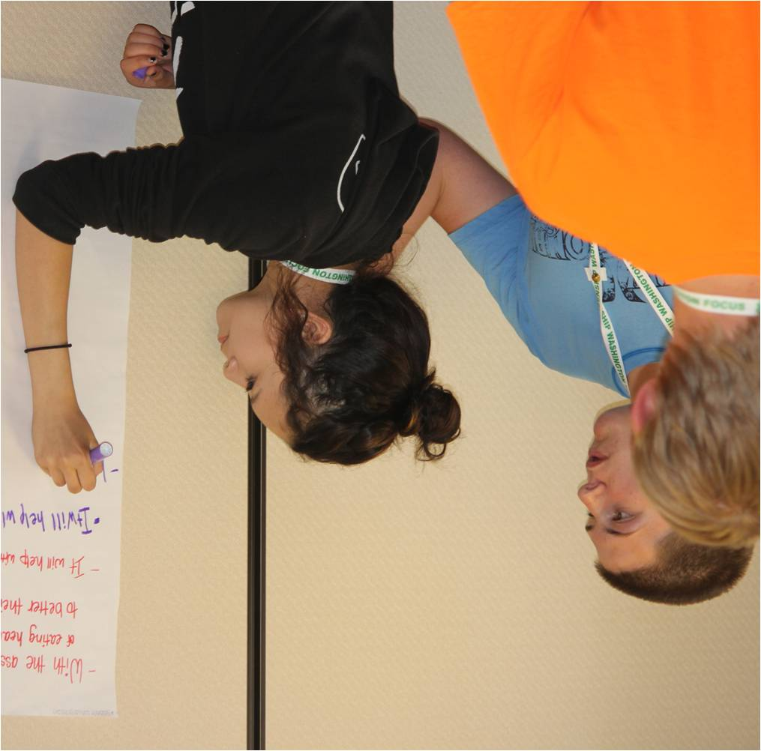
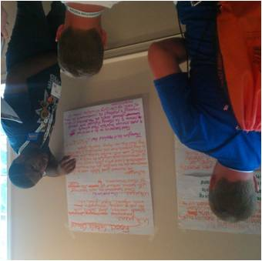
What are Workshops?
Workshops are sessions that focus around citizenship and leadership, you will discuss your role, thoughts and ideas as a citizen and leader in our ever changing society.
Delegates will explore issues that matter most to them; write bills based on those issues and stand up for them in the Congressional Session as the 4-H CWF House of Representatives is convened.
Notes:
Workshops
Delegates will progress though a series of workshops during their week starting with the basics of good citizenship and culminating with action planning for their own communities. Workshops are facilitated by our highly trained collegiate program assistants.
Open dialogue and varying perspectives are the critical elements for this workshop as delegates discuss several national issues that our country is currently facing to gain an understanding of how similar issues relate to every citizen.
Issues have included: Youth Labor in Agriculture, Food Labeling, Renewable Resources, Regulations on School Lunches, College Tuition Rates and Federal Funding for Arts Programs in Schools.
Delegates receive in-depth instruction about the bill writing process that takes place in the House of Representatives and use this knowledge to compose a bill of their own that addresses current issues facing their country and communities.
Delegates receive in-depth instruction about the bill writing process that takes place in the House of Representatives and use this knowledge to compose a bill of their own that addresses current issues facing their country and communities.
Putting practice into action. Using all that they have learned, delegates will discuss issues important to their communities and develop Action Plans to take home to their schools and communities.
Delegates learn about varying resources on Capitol Hill and prepare for their day of speaking to their members of congress about issues important to their constituencies

Slide 41
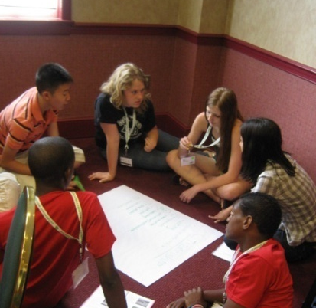
What are Committees?
Committees are groups of delegates who work together to
focus on a particular project throughout CWF.
Each delegation’s youth will be able to choose from the
following committees-
Focus on Healthy Living-
Create and run health and Fitness activities for the CWF Derby, a program highlighting the importance of Healthy Lifestyles.
Focus on Communication-
Produce the CWF newsletter and slideshow to be viewed by the entire CWF Group.
Learn publishing skills such as: writing, proof reading, page layout, photography, and Microsoft Power Point
Focus on Government-
Organize, plan, and execute the congressional session and the materials that accompany it.
Learn congressional processes, and parliamentary procedure, along with government related topics of interest.
Notes:
You will choose committees when you arrive.

Slide 42
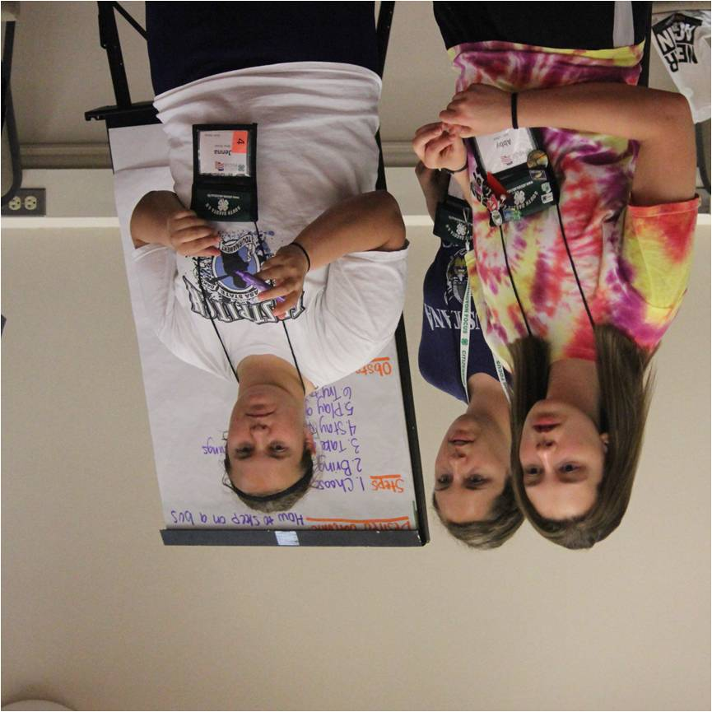
Focus on talent-
Organize, plan, and execute the CWF Talent Show and Auditions.
Learn the skills necessary to organize and promote an event.
Learn various audio/visual techniques necessary to produce a live show.
Focus on Responsibility-
Learn how to create an action plan to tackle an issue in your community.
Help facilitate Action Planning in your Delegation
Learn about telling your 4-H story thorough the 4-H revolution of Responsibility.
Focus on Open Mindedness-
Discuss important issues seen within your various communities and how youth can become involved.
Develop the skills to facilitate respectful discussions on important topics amongst a group of your peers.
Facilitate the Town Hall Meeting

Slide 43
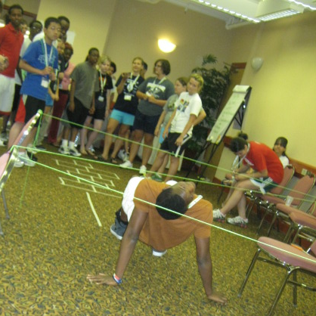
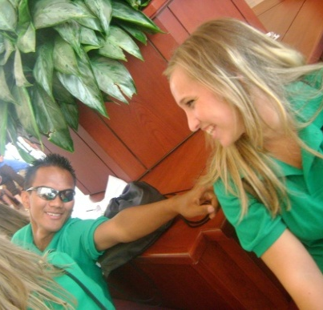
Delegate Expectations
Full participation
CWF is full of awesome learning and social opportunities. We expect that every delegate participate fully in all aspects of the program
Respect
During this once in a lifetime opportunity, delegates will interact with people who may have different views from them and visit some of our nation’s most sacred sites. We expect all delegates to treat one another and their surroundings with the utmost respect.
Dress code
During CWF we adhere to a dress code to insure that all delegates accurately represent the prestige of their delegation, 4-H and the CWF program.

Slide 44
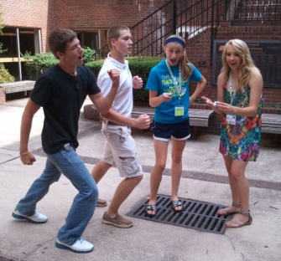
Dress Code
Next to each event on the schedule you
will find a dress code key. This key tells
you what level of dress is most
appropriate for its corresponding event.
Casual (c)
Clothes you would normally wear. Jeans, tennis
shoes, t-shirt etc.
Very casual (vc)
Clothes you wouldn’t mind getting wet or dirty

Slide 45
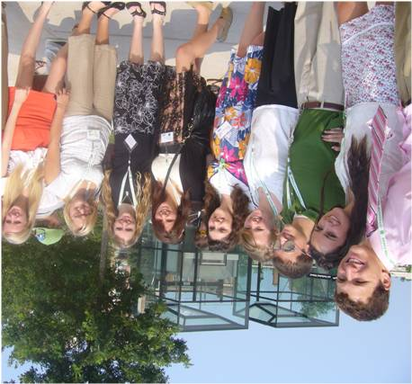
Business casual (bc)
Clothes you would wear in a business/office setting;
dress slacks and collard shirt for men, same for ladies as
well as skirts, blouses, etc.
Dress(d)
Clothes you would wear to a nice restaurant or special
occasion. Very similar to business casual.
CWF
Your green CWF polo and khaki pants (worn on Capitol
Hill day).
*ladies are asked to wear tops that cover their shoulders during the
visit to the
National Cathedral
*CWF involves a lot of walking, make sure you bring comfortable
shoes

Slide 46
Plans of Action
Each county to complete a minimum of one Service Learning Project
Each county will need to submit Service Learning Proposal for pre-approval no later than June 15, 2016
Have until December 31, 2016 to complete the project
Complete a 4-H Delivers story
Notes:
Jenna: Explain the process for the Plans of Action
Plan to discuss and present your project during CWF to your peers

Slide 47
Capitol Hill Day and Congressional Appointments :Wednesday June 28, 2017
Meeting with Senators, Representatives, and Legislative Staff.
Attend congressional committee hearings and visiting the Senate or House Galleries
Tour Capitol
Visiting other government sites in the area
Notes:
Make appointments between 10AM-2PM on June 28, 2017
Schedule as early as possible or directly after lunch.
Schedule 20 minutes between appointments
Confirm your appointments when you arrive in D.C
NOTE: APPOINTMENTS WITH SENATORS ARE BEING HANDLED AT THE STATE OFFICE….PARTICIPANTS SHOULD ONLY SCHEDULE APPOINTMENTS WITH THEIR CONGRESS PERSON
Scott to create a google document that participants can populate once they have confirmed appointments with their congress person.

Slide 48
Delegation Day
Multiple Tours Available
Will be touring the Holocaust Museum as a group
Smithsonian Museums etc.
Will use the Metro and bus systems
Arrival back to National Conference Center by 5:30PM
Notes:
Holocaust Museum Tour has been booked 11:30am entry
Lunch at the USDA building cafeteria (lunch on your own)
Remainder of the day can be used to see Smithsonian Museums and other sites.
Can split up in small groups with chaperones/ designated meeting location and time for return trip

Slide 49
Information Specific to California
Chaperone Packet will be emailed to each chaperone by June 5
Each delegate will be emailed a travel packet by June 5th provided all forms and money have been received.
Chaperone Orientation Webinar TBD
Notes:
Scott
Chaperone packet will include:
Contact information for all California Participants
Travel information by county ( flights and shuttles)
Medical information forms by county
Travel Itinerary for delegation
Delegate packet will include:
Individual specific travel information
Contact sheet for all California Participants
Travel Itinerary
Chaperone Call will be set up. Doodle will be sent out.

Slide 50
Things to Pack
Complete packing list and dress code explanations are on the CWF website
http://www.4hcenter.org
comfortable walking shoes
Comfortable dress shoes for Capitol Hill Day
Light clothes ( weather is HOT & Humid)
Umbrella or rain gear
Camera
Spending money
Notes:
Jenna

Slide 51
Reminders
Final payment due no later than May 21, 2017
Return Medical Form and Media release to Scott by May 31, 2017
Travel Packets will not be sent out until all forms and money are received
Notes:
Scott-Go over Agenda

Slide 52
Contact Information
Scott Mautte
scmautte@ucanr.edu
Office 530-750-1335
Personal Cell 530-718-9393
National 4-H Conference Center
301-961-2800 (24 hours)
Front Desk:
301-961-2801 each room has an extension
Jenna Colburn
Service Learning Contact
jcolburn@ucanr.edu
Office 530-750-1336
Notes:
Scott
Survey will be sent requesting current cell phone information for all participants.
Reminders:
Chaperone Call will be scheduled doodle will be sent out.
Preparing for Legislative appointments webinar will be scheduled.
Email with required forms will be coming please return them promptly
Email with itinerary will be sent
Make your legislative appointments & notify Shanna for master list
Work on your plan of action

Slide 53
Social Media
Notes:
To keep everyone updated at home. We would like to have social media captains.
Create a hashtag in addition to the one CWF will want us to use.

Slide 54
Questions
Notes:
Scott
Ask away

