Slide 1

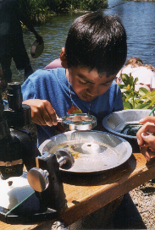

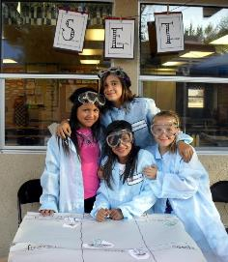
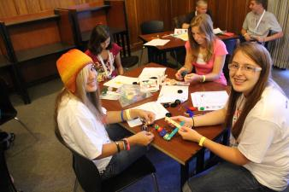

Hands On! Minds On! Inquiry Learning
Bridging the Bay
Region 4 Afterschool Programs
February 1, 2014
Steven Worker & Anne Iaccopucci
4-H Youth Development Program
Notes:
ANNE

Slide 2
Agenda
(10m) Welcome, Introductions, and Overview
(20m) Activity 1: Swamp Slugs!
(30m) Activity 2: Build a Swamp Slug Boat
(15m) Activity 3: Science Inquiry and Experiential Learning
(15m) Review & Evaluation
Notes:
ANNE

Slide 3

Take Home #1
Take Home #2
Educational activities should involve an intentional combination of hands-on activities, with purposeful debriefing, and authentic application.
This is called the experiential learning cycle.
Some activities should involve youth-planned and led investigations into phenomena with minimal instruction from an adult.
This is called inquiry-based learning.
Notes:
ANNE

Slide 4
Swamp Slugs
Instructions
  On your table you will find a glass with some swamp slugs.
  As a group take a few minutes to observe the swamp slugs and their behavior.
  Discuss your observations.
  Identify several questions you have concerning your observations.
Notes:
STEVEN

Slide 5
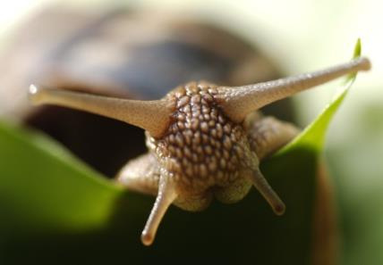
Swamp Slugs
What were some of your observations?
What questions to do you have?
How can you find answers or test your hypothesis?
Conduct an investigation.
Notes:
STEVEN

Slide 6
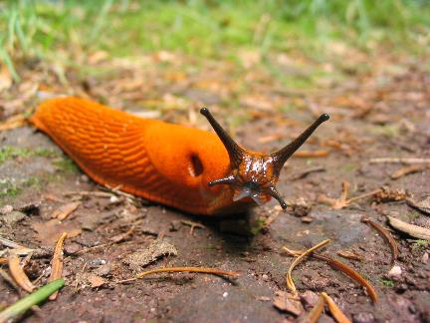
Swamp Slugs
What new observations did you make?
What did you learn?
What else would you like to know?
How could you use what you learned in other situations?
Notes:
STEVEN

Slide 7
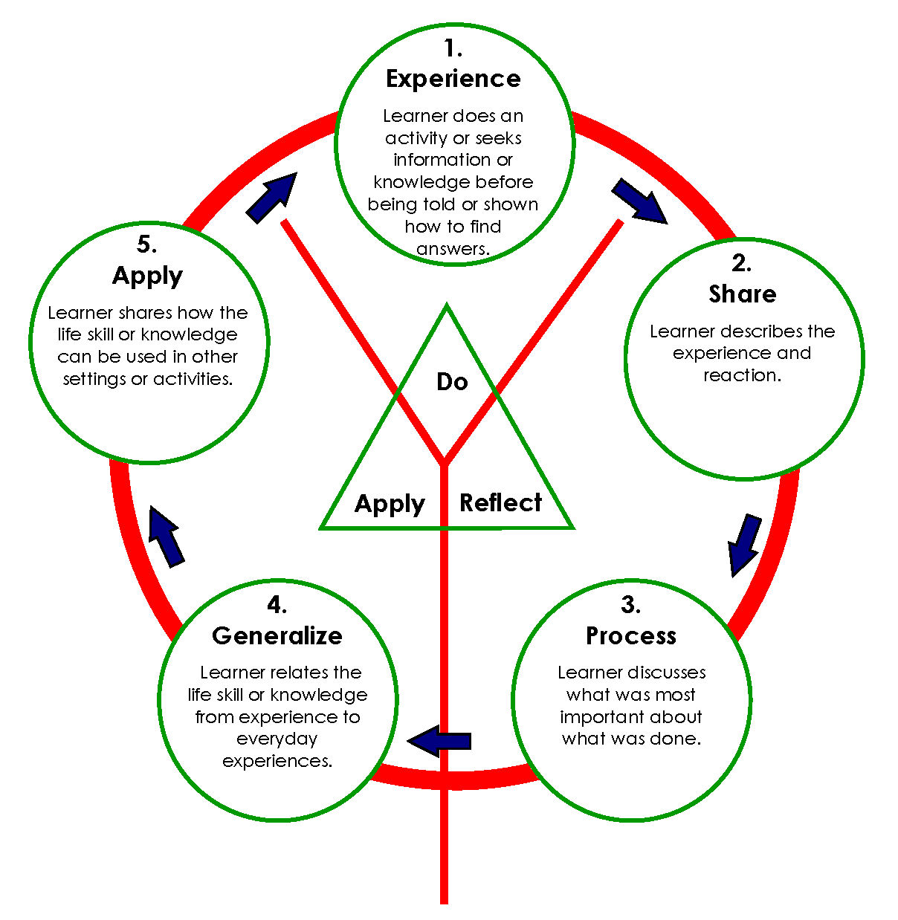
Experiential Learning
Experience
(Activity)
Reflect
(Share & Process)
Apply
(Generalize and Apply)
Connect to real-life.
Notes:
ANNE

Slide 8

Further Inquiry … Swamp Slugs
Imagine:
Swamp slugs only exist on a remote island
Potential to provide rich food source to famine stricken areas
Must be quickly transported over water
Few materials to build boats
At least 20 slugs per trip for survival
Notes:
ANNE

Slide 9
Further Inquiry … Swamp Slugs
Share the two group experiences.
Share your experience.
  What did you do to get started?
  How did you test your prototype?
  Did you try other options or change your plans?
What did you learn about getting your boat to float? To carry the minimum number of swamp slugs?
Notes:
ANNE

Slide 10
Further Inquiry … Swamp Slugs
Share the two group experiences.
What were some of the similarities and differences of the two groups’ experiences?
What conclusions can you draw from the two experiences?
How could you use some of the learning in other situations?
How might children respond to these two experiences?
How might this be applied to other afterschool learning?
Notes:
ANNE

Slide 11
Inquiry
A learning environment where youth are engaged in open-ended, learner-centered, hands-on activities.
Youth seek answers to questions rather than being given answers.
Facilitating an open discussion is crucial in promoting inquiry.
Notes:
STEVEN

Slide 12
Inquiry
Open/Full – “doing science” – youth formulate their own problem to investigate.
Guided - The educator provides only the materials and problem to investigate. Students devise their own procedure to solve the problem.
Directed/Structured – “cookbook” - The educator provides youth with a hands-on problem to investigate, as well as the procedures but does not inform them of expected outcomes.
Notes:
STEVEN

Slide 13

Inquiry includes …
1. Asking questions and defining problems.
2. Developing and using models.
3. Planning and carrying out investigations.
4. Analyzing and interpreting data.
5. Using math and computers.
6. Constructing explanations and designing solutions.
7. Engaging in argumentation from evidence.
Obtaining, evaluating and communicating information.
How were these used in the experience?
Notes:
STEVEN

Slide 14
Role of the Facilitator / Educator
Teacher
Guide Facilitator
Notes:
STEVEN

Slide 15
Asking open-ended questions
Why is it important to ask questions?
What kinds of questions are there?
Notes:
STEVEN

Slide 16
Asking open-ended questions
Closed Questions
have a limited number of acceptable responses or
“right answers”.
Often begin with who, what, when, where, and name, and sometimes how and why .
They limit discussion.
Open Questions
those that can be explored further, don’t have a single “right” answer
They promote discussion!
Use terms: discuss, interpret, explain, evaluate, compare, if, or what if.
Notes:
STEVEN

Slide 17
Question time
In table groups, based on your slug boat experience, create one question for each of the six categories.
Notes:
STEVEN

Slide 18
Take Home #1
Take Home #2
Educational activities should involve an intentional combination of hands-on activities, with purposeful debriefing, and authentic application.
This is called the experiential learning cycle.
Some activities should involve youth-planned and led investigations into phenomena with minimal instruction from an adult.
This is called inquiry-based learning.
Notes:
STEVEN

Slide 19
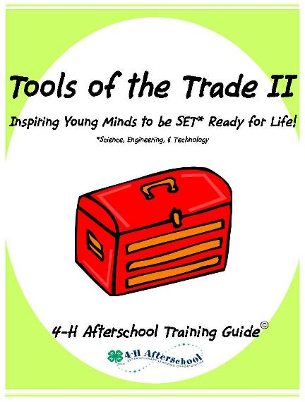
Tools of the Trade II
Uses a “train-the-trainer” approach
Provides 22-hours of training modules
Geared to frontline staff and youth workers
Uses a hands-on, interactive skill-building approach
Provides tools drawn from research and best practices
Covers SET topics including: inquiry, SET-rich environments, curriculum, centers and teens as teachers
Notes:
STEVEN

Slide 20






What is 4-H?
4-H is a nonformal youth education program for young people (ages 5-19). Nationally, over 7 million youth participate in 4-H through clubs, afterschool programs, camps, and school enrichment activities.
4-H academics develop curriculum, conduct evaluation, and advance the field of research in out-of-school time learning.
County Governments
Notes:
ANNE

Slide 21


Slide 22
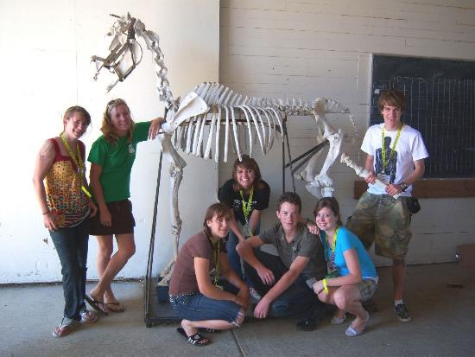
4-H Program Framework
Educational Practices
Project-based learning
Experiential learning
Inquiry-based instruction
Collaborative learning
Service learning
Youth Development Practices
Safety
Relationship building
Youth engagement (youth-adult partnerships)
Community involvement
Skill building
http://www.ca4h.org/files/146514.pdf
Notes:
ANNE

Slide 23
4-H Resources
Utilize our program and fund development materials
Professional Development
Utilize 4-H materials or invite local 4-H staff to help facilitate workshops.
Curricula
As a public youth development organization, 4-H materials are often available for free or low cost. Materials are often peer reviewed for accuracy and quality.
Learn from our research, evaluation, and promising practices
4h.ucanr.edu
Notes:
ANNE

Slide 24
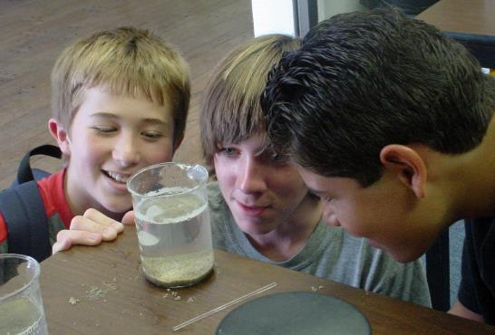
Hands On! Minds On! Inquiry Learning
Steven Worker
4-H Science, Engineering, and Technology Coordinator
smworker@ucanr.edu
530-754-8519
Anne Iaccopucci
4-H Health Living Coordinator
amiaccopucci@ucanr.edu
530-750-1339
4-H Youth Development Program

