Slide 1
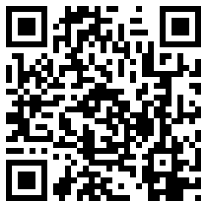
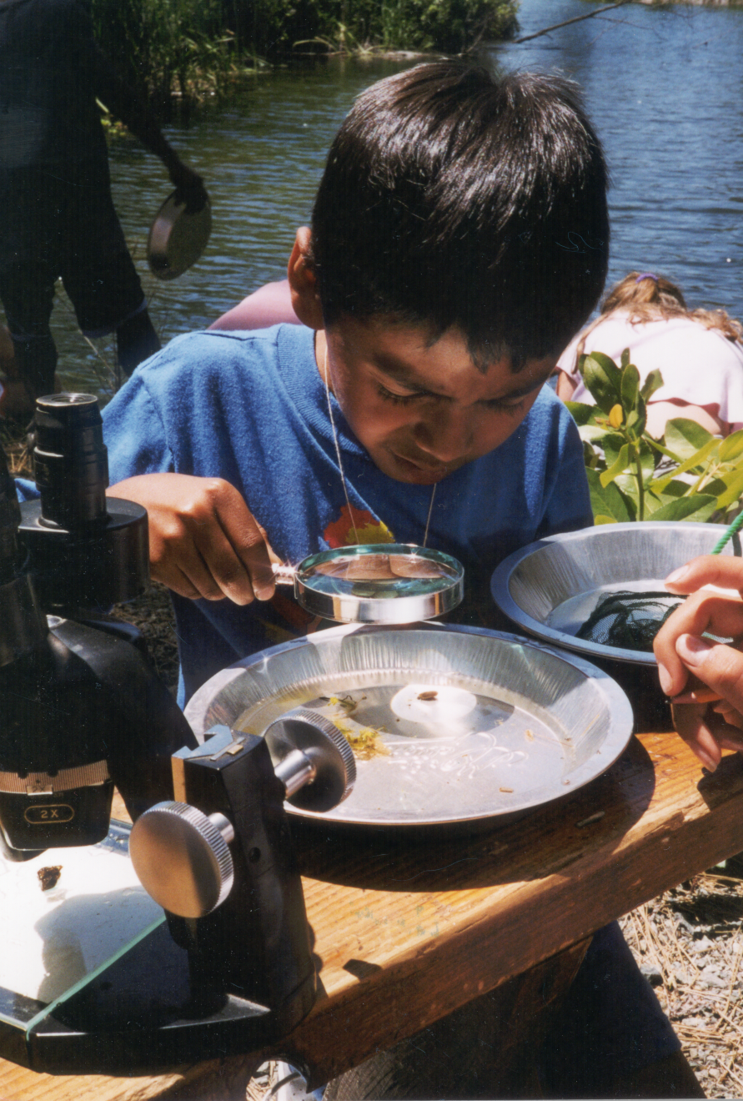
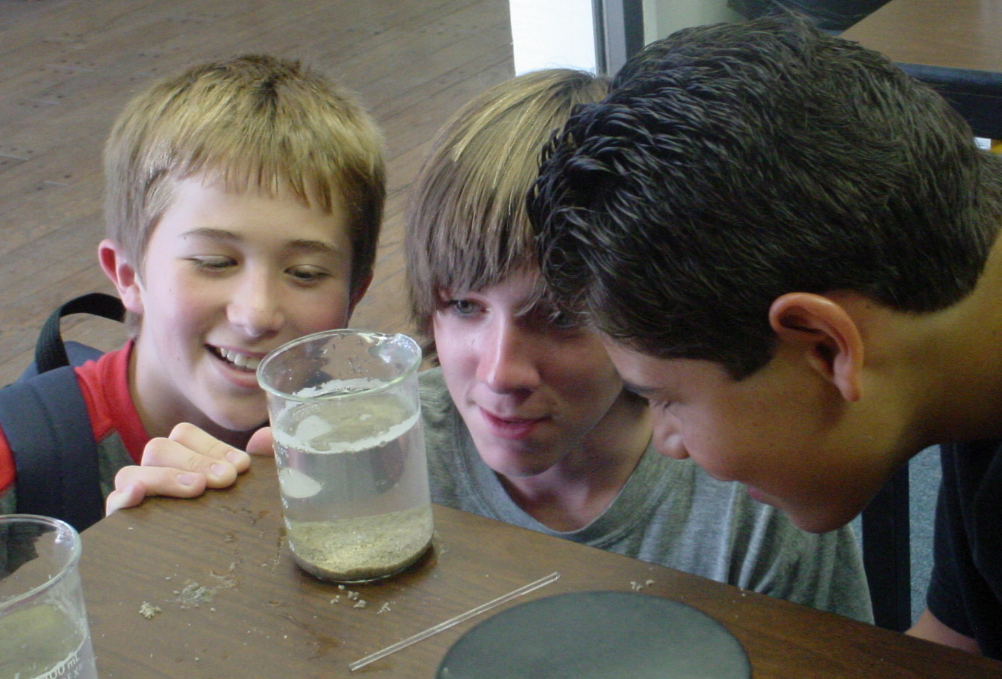
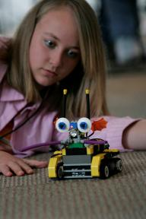
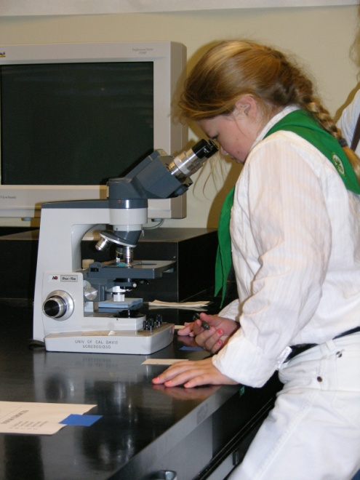
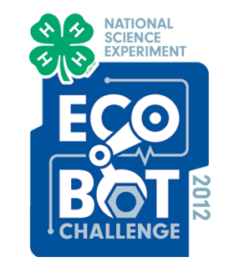
4-H Science, Engineering, and Technology
Since 1913, California 4-H has engaged youth in programming to help improve their scientific literacy.
4-H engineering programs ask youth to design and build.
4-H members used scientific tools while learning about animal science and veterinary science.
4-H members engaged in water quality testing in one of many 4-H science programs focused on water education.
Youth explored the environment and then applied that knowledge to restoration projects.
4-H Science Programming
4-H Youth Development
Get Involved!
Goals of 4-H Science Programs
Help address the critical need for more scientists and engineers.
Expected Outcomes
Help youth improve their knowledge, skills, and attitudes around science, engineering, and technology.
Connect learning with real-world situations where youth can adopt and use new science methods, engineer designs, or improve technology to solve authentic issues.
In the long term, increase the number and diversity of youth pursuing higher education and careers in science, engineering, and technology.
4-H serves young people, ages 5-19, in reaching their fullest potential as healthy, happy, thriving people who make a positive contribution in their communities.
4-H involves youth in urban, suburban and rural communities.
4-H science and engineering programs combine the strengths of experiential education and inquiry-based science learning with a positive youth development framework that holistically addresses the developmental and educational needs of young people.
Utilize 4-H Curricula
High-quality experiential and inquiry-based 4-H curricula foster the natural curiosity and creativity of youth.
http://www.4-hdirectory.org/
Encourage Youth to Participate in 4-H
4-H provides experiences that promote a strong sense of belonging, opportunities for community service and leadership development. http://www.ca4h.org/join/
Conduct the 4-H National Youth Science Experiment
The experiment brings together youth, volunteers, and educators annually to spark an interest in science. http://www.4-h.org/nysd/
Contact California 4-H at
www.ca4h.org | 530-754-8518
Steven Worker, smworker@ucanr.edu
See 4-H members in action at
http://www.youtube.com/California4H
Printed for the California Science Teachers Association Conference, October 19 & 20, 2012

